Slide 1




CRAI AI Bootcamp 2025
Introduction to Data Analysis
By
Fatima Muhammad Adam
Department of Computer Science

Slide 2


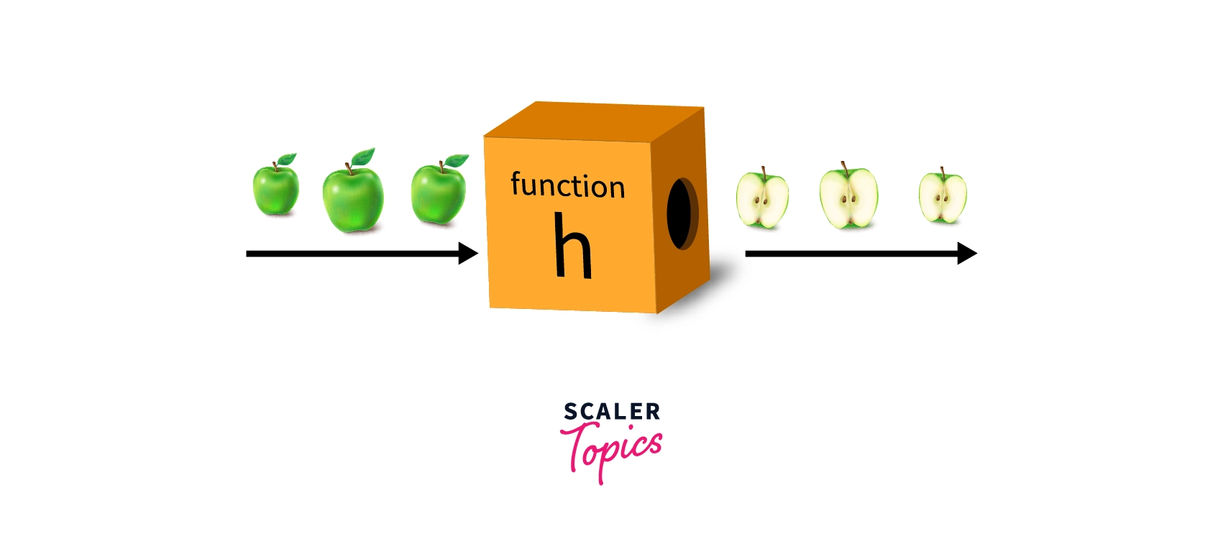
01
Functions and Modules
Building reusable code blocks, delve into built-in Python functions and importing external modules.

Slide 3
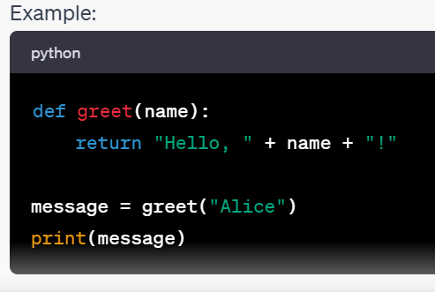
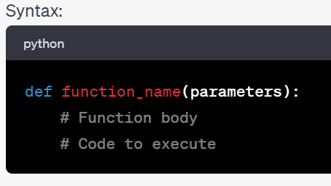
—Someone Famous
Functions
Functions are blocks of reusable code that perform specific tasks.
They allow you to organize your code, make it more readable,
and avoid repetition.
To create a function in Python, use the def keyword, followed by the function name and parentheses.

Slide 4
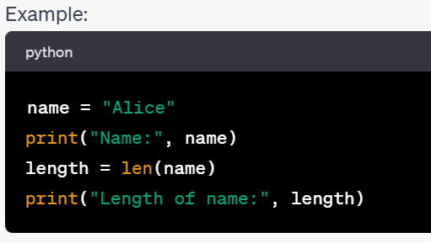
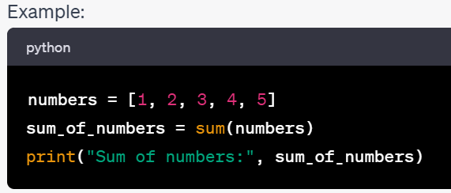
Built-in Functions
Python provides a wealth of built-in functions
that perform common tasks.
These functions can be used without the need for
defining them.
Examples of built-in functions include:
print(): Used to display output.
len(): Returns the length of a sequence (e.g., a list or a string).
sum(): return summation of list of tuple.

Slide 5
Stages involved in Building Machine learning models
Importing all the necessary libraries
05
Building the model
01
04
Exploratory Data Analysis
Reading Data set
02
03
Data Preprocessing

Slide 6
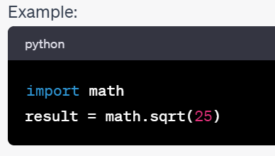

Importing and Using Modules
Python modules are collections of related functions and code that can be reused in different programs.
You can import modules using the import statement.
Importing modules allows you to access additional functionality not available in Python's built-in functions.
We can see all the names in module using the built-in function dir().

Slide 7
Python packages for data analysis
Scientific computing libraries
Algorithmic libraries
Visualization libraries
scikit-learn(machine learning: regression & classification)
statsmodels(explore data, estimate statistical models & perform statistic test)
Pandas(Data structure and tools)
Numpy(Array and Matrices)
Scipy (integrals, solving differential equation and optimization )
Matplotlib(plots & graph , most popular)
Seaborn(plots: heatmaps, time series, violin plots)

Slide 8


02
NumPy and Arrays
A fundamental library for numerical operations

Slide 9

NumPy, short for Numerical Python, is a powerful Python library for numerical and array-based operations. It provides support for large, multi-dimensional arrays and matrices, along with a collection of mathematical functions. NumPy is a fundamental library for data science, machine learning, and scientific computing. Numpy ndarray for creating multiple dimensional arrays NumPy-based algorithms are generally 10 to 100 times faster We'll explore its capabilities and how to get started with NumPy in our interactive python notebook.
NumPy

Slide 10
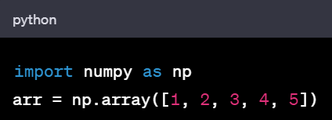
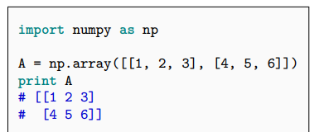
NDarray
NumPy adds a new data structure to Python(ndarray)
An N-dimensional array is multidimensional container of items of the same type and size.Defined by:
the shape of the array, and
the kind of item the array is composed of
The shape of the array is a tuple of N integers (one for each dimension)

Slide 11
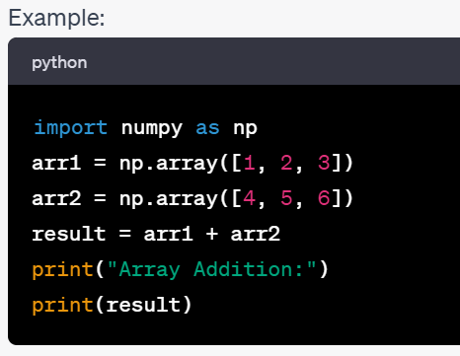
Basic Operations with NumPy Arrays
NumPy arrays support a wide range of mathematical and element-wise operations.
You can perform operations such as addition, subtraction, multiplication, and more on arrays.
NumPy simplifies complex numerical computations.

Slide 12
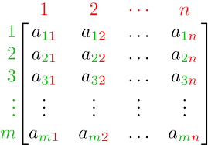
Basic Operations with NumPy Arrays
numpy_zeroes = np.zeros((3,3),dtype=int,order='C')
numpy_zeroes
four_by_four_matrix = np.matrix(np.ones((4,4), dtype=float))
four_by_four_matrix
np.asarray(four_by_four_matrix)[2] = 2
four_by_four_matrix

Slide 13
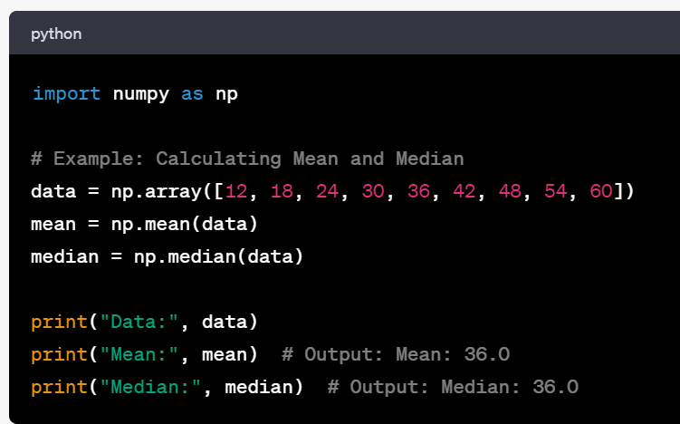


Slide 14
Official documentation http://docs.scipy.org/doc/ The NumPy book http://www.tramy.us/numpybook.pdf Example list http://www.scipy.org/Numpy_Example_List_With_Doc
NumPy documentation

Slide 15

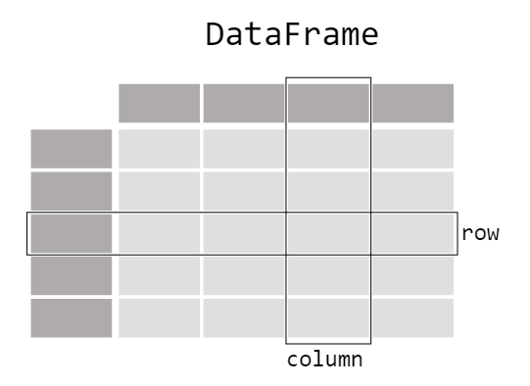
03
Panda
a Python library that provides easy-to-use data structures and data analysis tools.

Slide 16
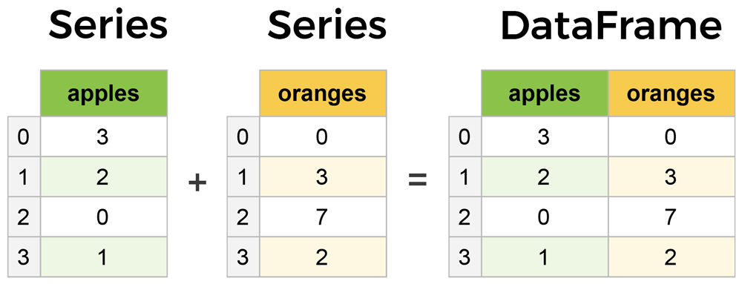
Series & DataFrames
The primary two components of pandas are the Series and DataFrame.
Series is essentially a column, and
DataFrame is a multi-dimensional table made up of a collection of Series.

Slide 17
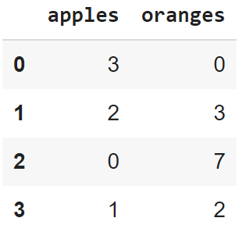

Creating a DataFrame from scratch
There are many ways to create a DataFrame from scratch, but a great option is to just use a simple dict. But first you must import pandas.
Let's say we have a fruit stand that sells apples and oranges. We want to have a column for each fruit and a row for each customer purchase. To organize this as a dictionary for pandas we could do something like:
And then pass it to the pandas DataFrame:
import pandas as pd
data = { 'apples':[3, 2, 0, 1] , 'oranges':[0, 3, 7, 2] }
df = pd.DataFrame(data)

Slide 18
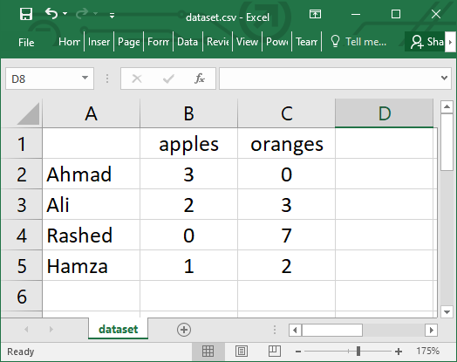
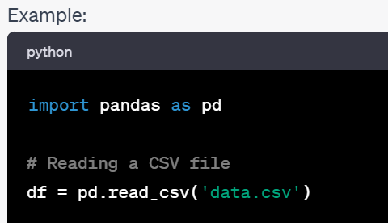
Reading data from a CSV file

Slide 19
Viewing your data
The first thing to do when opening a new dataset is print out a few rows to keep as a visual reference. We accomplish this with .head():
.head() outputs the first five rows of your DataFrame by default, but we could also pass a number as well: df.head(10) would output the top ten rows, for example.
To see the last five rows use .tail() that also accepts a number, and in this case we printing the bottom two rows.:
df.head()
df.tail(2)

Slide 20
Recap on Last class
Importing dataset
Format e.g csv, json, xlsx
File path of dataset(from system, or from online web http)
Types
Object
Int
Float
datetime
Basic insight of dataset

Slide 21
Understanding dataset
Describing dataset
Checking data information
df.info()
df.describe()
ProfileReport is a function (or class, depending on the library) that automatically generates a comprehensive and interactive HTML report summarizing the characteristics of a dataset. It's primarily used in data analysis and exploratory data analysis (EDA) to quickly gain insights into the data's structure, distributions, and relationships between variables.
#the data virtualization
!pip install pandas-profiling==2.7.1
from pandas_profiling import ProfileReport
ProfileReport(nameofdataset, minimal = True)

Slide 22
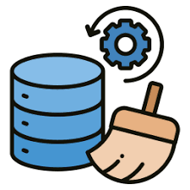
Data Wrangling
The process of converting or mapping data from the initial “row” form into another format in order to prepare the data for further analysis. Also called data preprocessing or data cleaning.

Slide 23
Data Wrangling
Identifying and handling missing values
Data formatting
Data normalization
Data Binning
Turning categorical to numeric variables

Slide 24
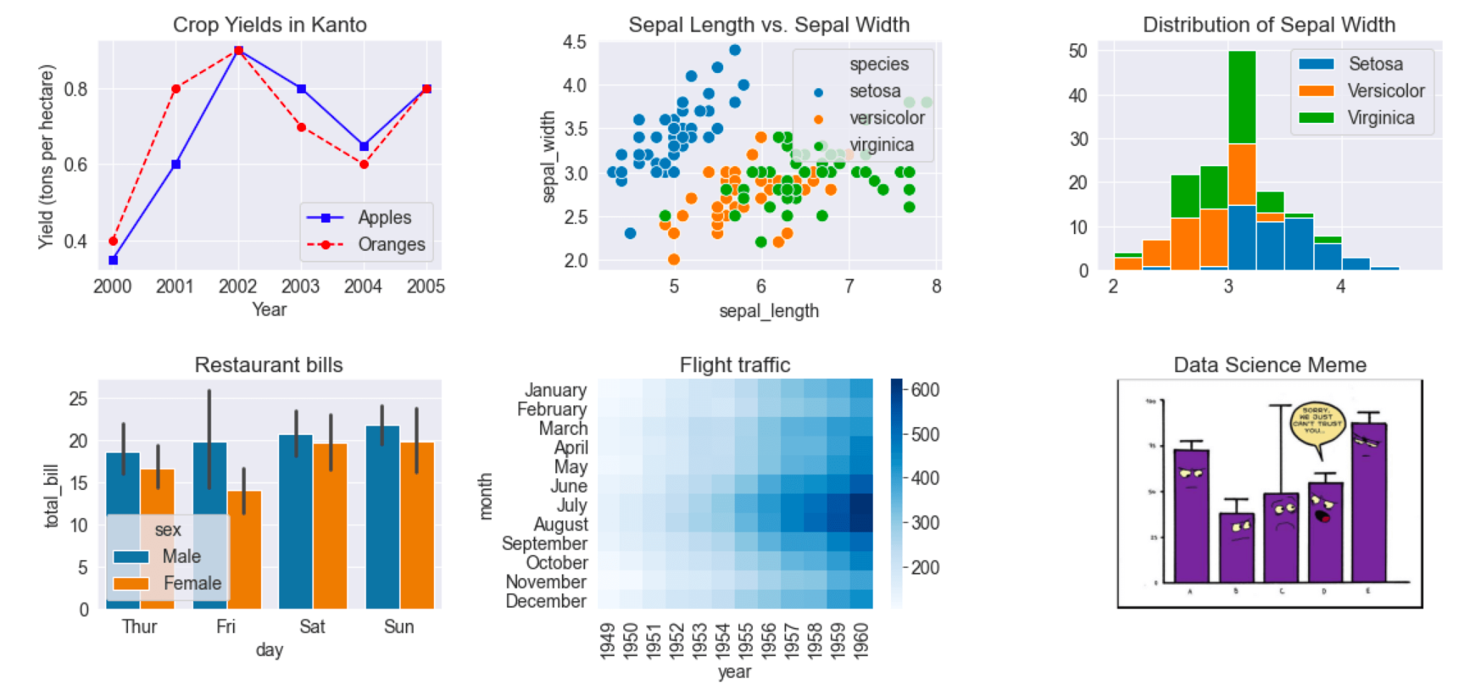
Matplotlib & Seaborn

Slide 25
Matplotlib & Seaborn
Matplotlib: A foundational Python library for creating static, interactive, and animated visualizations in Python. It offers extensive control over plot elements, enabling users to generate a wide variety of charts and figures.
Seaborn: Built on top of Matplotlib, Seaborn provides a high-level interface for drawing attractive and informative statistical graphics. It simplifies the creation of complex visualizations, particularly for exploring relationships between variables in datasets.

Slide 26
Some simple functions in Matplotlib
plt.plot(): Creates a line plot.
plt.scatter(): Creates a scatter plot.
plt.bar(): Creates a bar chart.
plt.hist(): Creates a histogram.
plt.pie(): Creates a pie chart.
plt.imshow(): Displays an image.
plt.title(): Sets the plot title.
plt.xlabel(): Sets the x-axis label.
plt.ylabel(): Sets the y-axis label.
plt.show(): Displays the plot.
plt.savefig(): Saves the plot to a file.

Slide 27
Some simple functions in Seaborn
sns.scatterplot(): Creates a scatter plot, often with hue or size variations.
sns.lineplot(): Creates a line plot, often with confidence intervals.
sns.barplot(): Creates a bar plot, often for categorical data.
sns.histplot(): Creates a histogram or a kernel density estimate (KDE) plot.
sns.boxplot(): Creates a box plot.
sns.violinplot(): Creates a violin plot.
sns.heatmap(): Creates a heatmap for visualizing correlation or matrix data.
sns.pairplot(): Creates a matrix of scatter plots for pairwise relationships.
sns.countplot(): Creates a count plot for categorical data.
sns.displot(): A figure-level interface for drawing distribution plots.

Slide 28
Click on these links for more on: Numpy, Pandas, & Matplotlib
https://medium.com/@fateemamohdadam2/unleashing-the-power-of-data-visualization-for-uncovering-new-insights-74d4116e5a9e
https://medium.com/@fateemamohdadam2/pandas-as-a-data-structure-and-data-manipulation-tool-f948f9ab7024
https://medium.com/@fateemamohdadam2/numpy-as-the-most-important-foundational-package-for-numerical-computing-in-python-aae237cabace

Slide 29


